Slide 1

Crypto Universe Crypto Data Pipeline Arian Bahadori

Slide 2

Overview
This project involves creating an ETL pipeline to fetch cryptocurrency data from the CoinMarketCap API, process and store it in a PostgreSQL database, and then visualize the data using a Streamlit dashboard.
This Photo is licensed under CC BY-SA-NC

Slide 3

Agenda
Overview
Problem statement
Solution
Methodology
Diagram
Demo
Limitations
Summary
Q&A

Slide 4
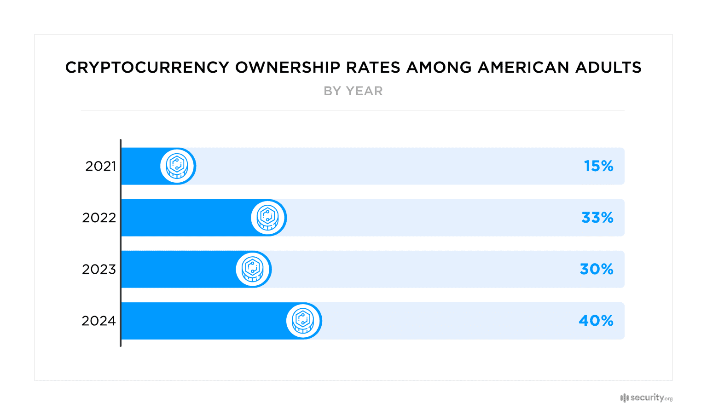
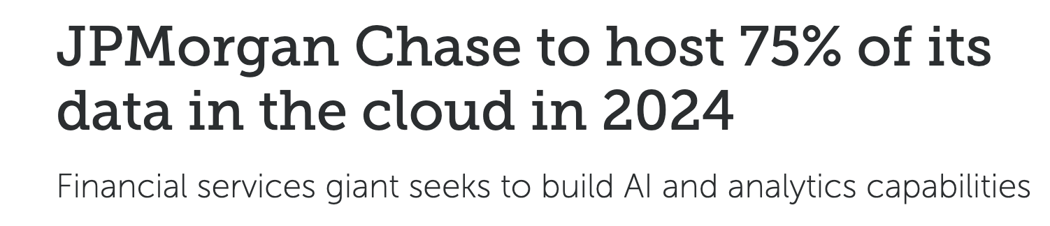

Problem statement
Banks
Projects
Crypto ownership
Banks and financial services need
improved security, enhanced decision-making, personalised services and optimise operations.
One of the areas that banks are heavily invested is cryptocurrency – hence they need enhanced processing of data.
Crypto awareness and ownership have continued to grow. Fewer than half of respondents were aware of cryptocurrency in 2021. But today, more than 80 percent said they were familiar with the financial technology.

Slide 5
Solution
Cloud adaptation
Reduce Costs
Enhance Scalability
Improve Agility
Boost Security
Enable Innovation
Target audience
Banks
Financial Institutions
Solo Traders
Government Agencies
Energy Sector
Payment Processors
Data Processing
Enhance Decision-Making
Personalize Services
Ensure Compliance
Improved Security
Detect and prevent fraud
Optimise Operations

Slide 6




Methodology Overview
Extract
Transform
Load
Users
Extract data from a reliable source
Beautify the data if needed
Load into data warehouse
Use data for decision making

Slide 7
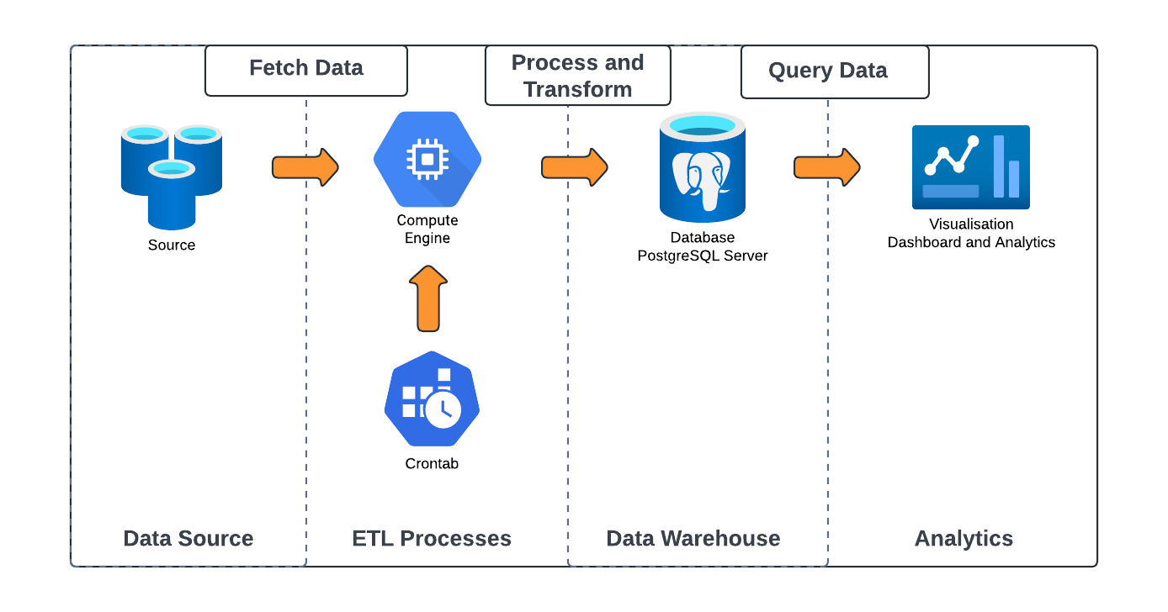
Extract transform load

Slide 8
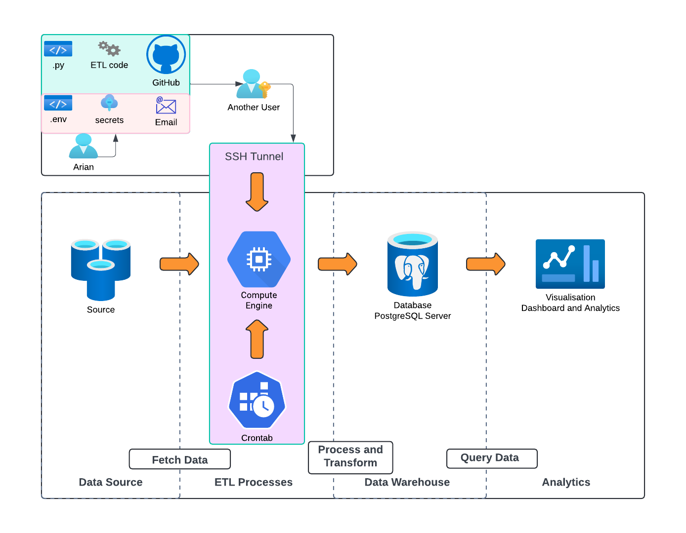

Slide 9
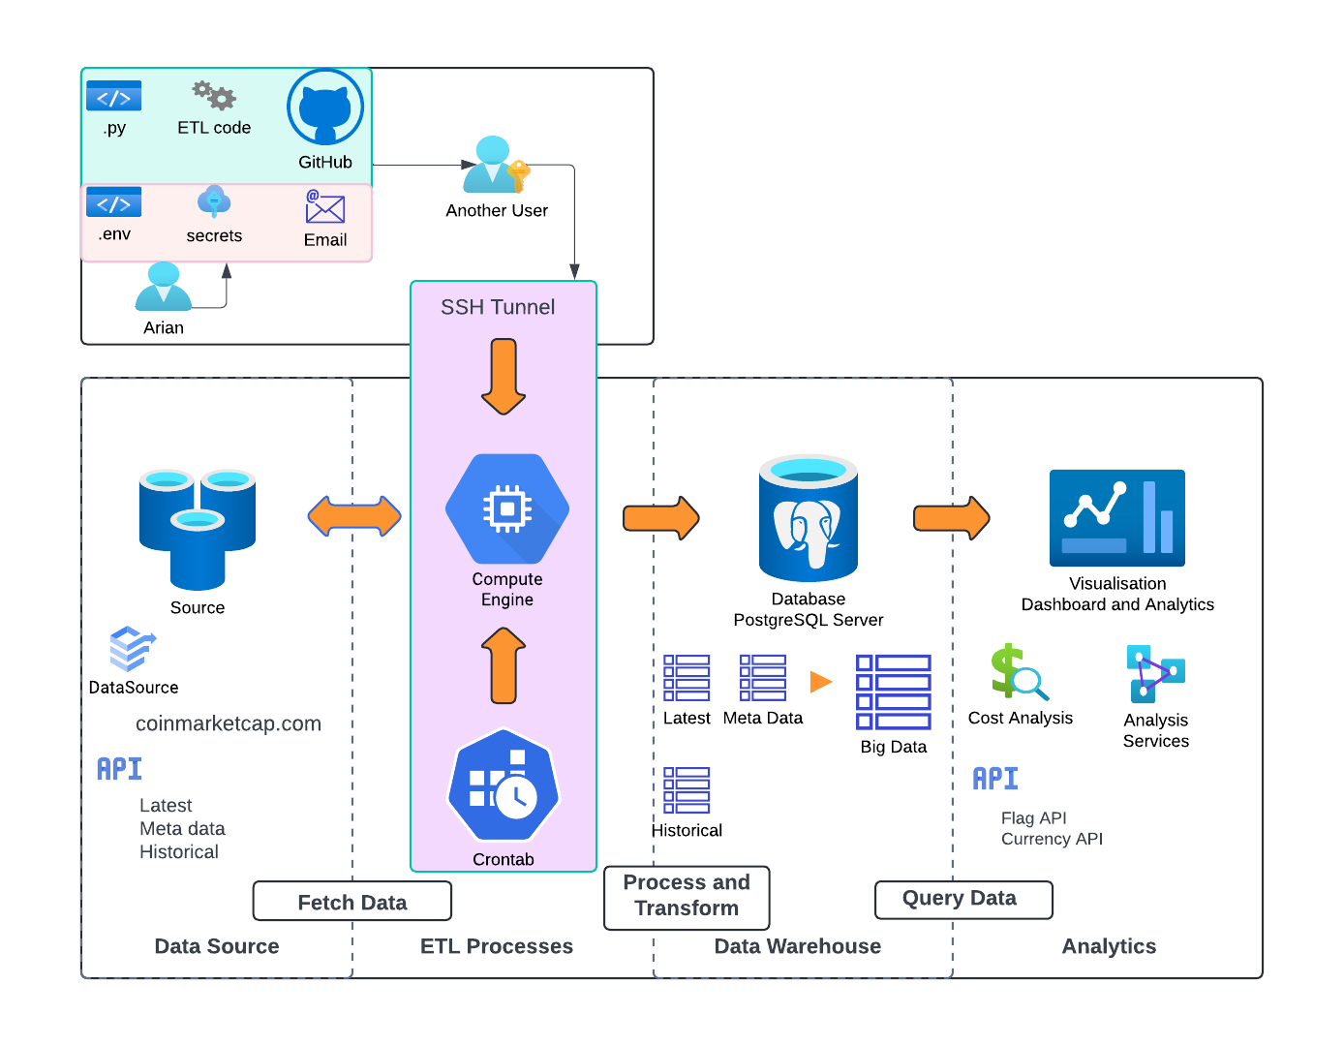

Slide 10
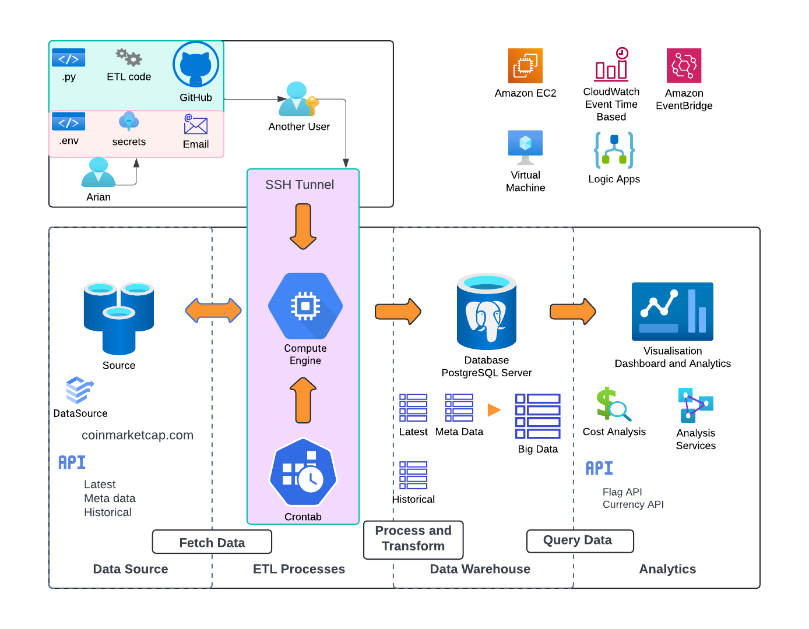

Slide 11

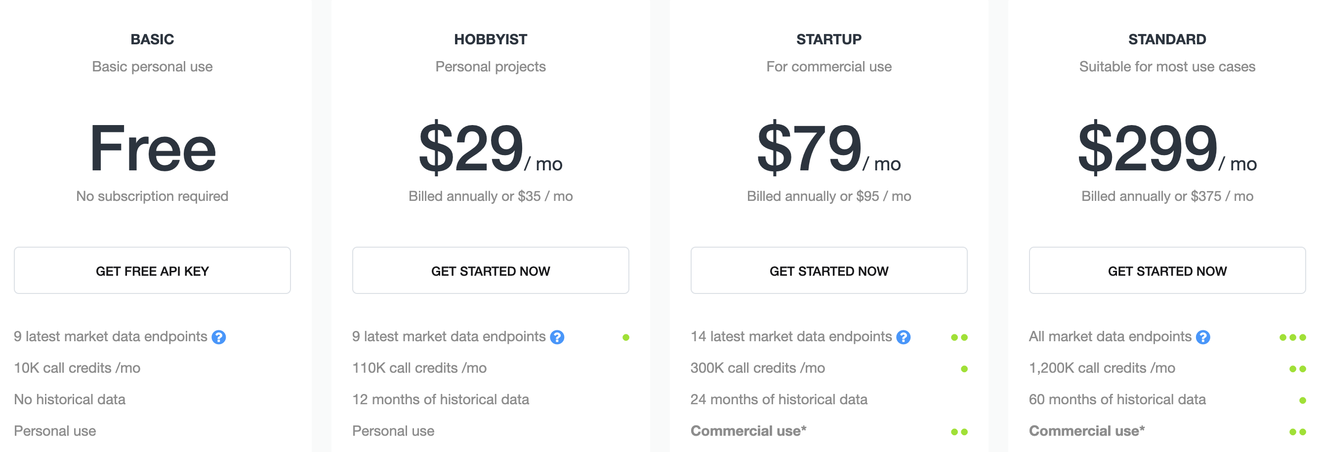
Limitations + Improvements
Free API:
Monthly API Credit: 10 k Support: Basic email Licence: Personal use Rate limit: 30 requests per minute Update frequency: Once every minute Currency Convert: 1 per call Rest API: 9 latest data endpoint Database: Unknown amount? Performance: Unknown processing?
This Means: Next Time:
No Historical API Get Historical API No Priority emails Use Caching No Commercial use Be More Experimental Limited API credits Ask for Help Lucid Chart Limitations Know your deadlines

Slide 12

Summary
This project involved creating an ETL pipeline to fetch cryptocurrency data for faster, more secure and optimised data processing.
Thank you for listening
Arian Bahadori

Slide 13

Any questions?

